Slide 1
COMPUTER VISION • DEEP LEARNING • HCI
Human Activity Recognition
(HAR) System
AI-Powered Computer Vision for Real-Time Motion and Pose Tracking
Presented by Akkisetti Ganesh | Registration No: 12524619
1 / 9

Slide 2



INTRODUCTION
Introduction & Problem Statement
What is HAR?
Core Challenges
Automated classification of human physical actions from video streams.
Intra-class variability
Background clutter
The Shift
Dynamic lighting conditions
Transitioning from intrusive wearables to non-contact, vision-based tracking.
Occlusions
2 / 9

Slide 3



GOALS
System Objectives
Real-Time Detection
High Throughput & Low Latency
Scalable Deployment
Automatically identify daily actions — walking, sitting, standing, falling.
Process high-FPS video streams efficiently with minimal delay.
Adapt seamlessly to smart homes, hospitals, and security systems.
3 / 9

Slide 4




APPROACH
Methodologies in Computer Vision
2D / 3D Pose Estimation
2D CNNs
Track joint keypoints using MediaPipe, OpenPose, and YOLO-Pose.
Extract visual spatial features on a frame-by-frame basis.
LSTMs / GRUs
3D CNNs & Vision Transformers
Model temporal action sequence patterns over time.
Process spatial and temporal dimensions simultaneously.
4 / 9

Slide 5




TECH STACK
Hardware & Software Stack
Programming Language
Computer Vision Libraries
Python 3.x
OpenCV, MediaPipe
Deep Learning Frameworks
Infrastructure
PyTorch / TensorFlow, Keras
HD Web / IP Camera + NVIDIA CUDA GPU
5 / 9

Slide 6

ENGINEERING
Technical Challenges & Solutions
CHALLENGE
SOLUTION
Occlusion & Clutter
Spatial attention modules applied on skeletal keypoints.
Viewpoint Variations
3D coordinate normalization and multi-angle training datasets.
Real-Time Edge Limits
Model quantization (TensorRT) and lightweight backbones (MobileNet).
6 / 9

Slide 7


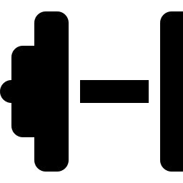
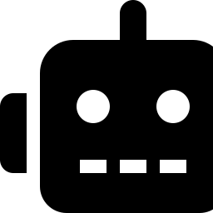
IMPACT
Real-World Applications
Healthcare & Senior Safety
Smart Security
Automated fall detection and emergency response dispatch.
Real-time detection of intrusions, fights, or anomalous events.
Fitness & Rehab
Smart Robotics
Posture analysis, form guidance, and exercise rep counting.
Touchless gesture control and safe human-robot interaction.
7 / 9

Slide 8


ROADMAP
Future Scope
Edge AI Integration
Multi-Modal Fusion
Zero-Shot Learning
Deployment on low-power edge devices such as Jetson Nano and Raspberry Pi.
Combining vision data with acoustic and thermal sensors.
Identifying unseen human actions without dense retraining.
8 / 9

Slide 9


WRAP-UP
Conclusion
HAR transforms raw video feeds into actionable real-time intelligence.
Skeletal tracking combined with sequence models powers intelligent monitoring systems.
Open for Questions & Discussion
Presenter: Akkisetti Ganesh | Reg No: 12524619
9 / 9

